Slide 1

DDOS ATTACK DETECTION

Slide 2
Contents
Project Description
Ddos attack
Proposed Solution Architecture
Requirements
Demo
Code Explained
Challenges Faced
Scaling
Questions

Slide 3

Project Description
The customer runs a website and periodically is attacked by a botnet in a Distributed Denial of Service (DDOS) attack. You’ll be given a log file in Apache log format from a given attack. Use this log to build a simple real-time detector of DDOS attacks.

Slide 4
Requirements
Reading the log file from HDFS
Analyzing data in HDFS
Put messages into Kafka
Read messages and run them through the Ddos detection tool.
Write the results(attacker IP) into a directory.
An attack should be detected one to two minutes after starting

Slide 5
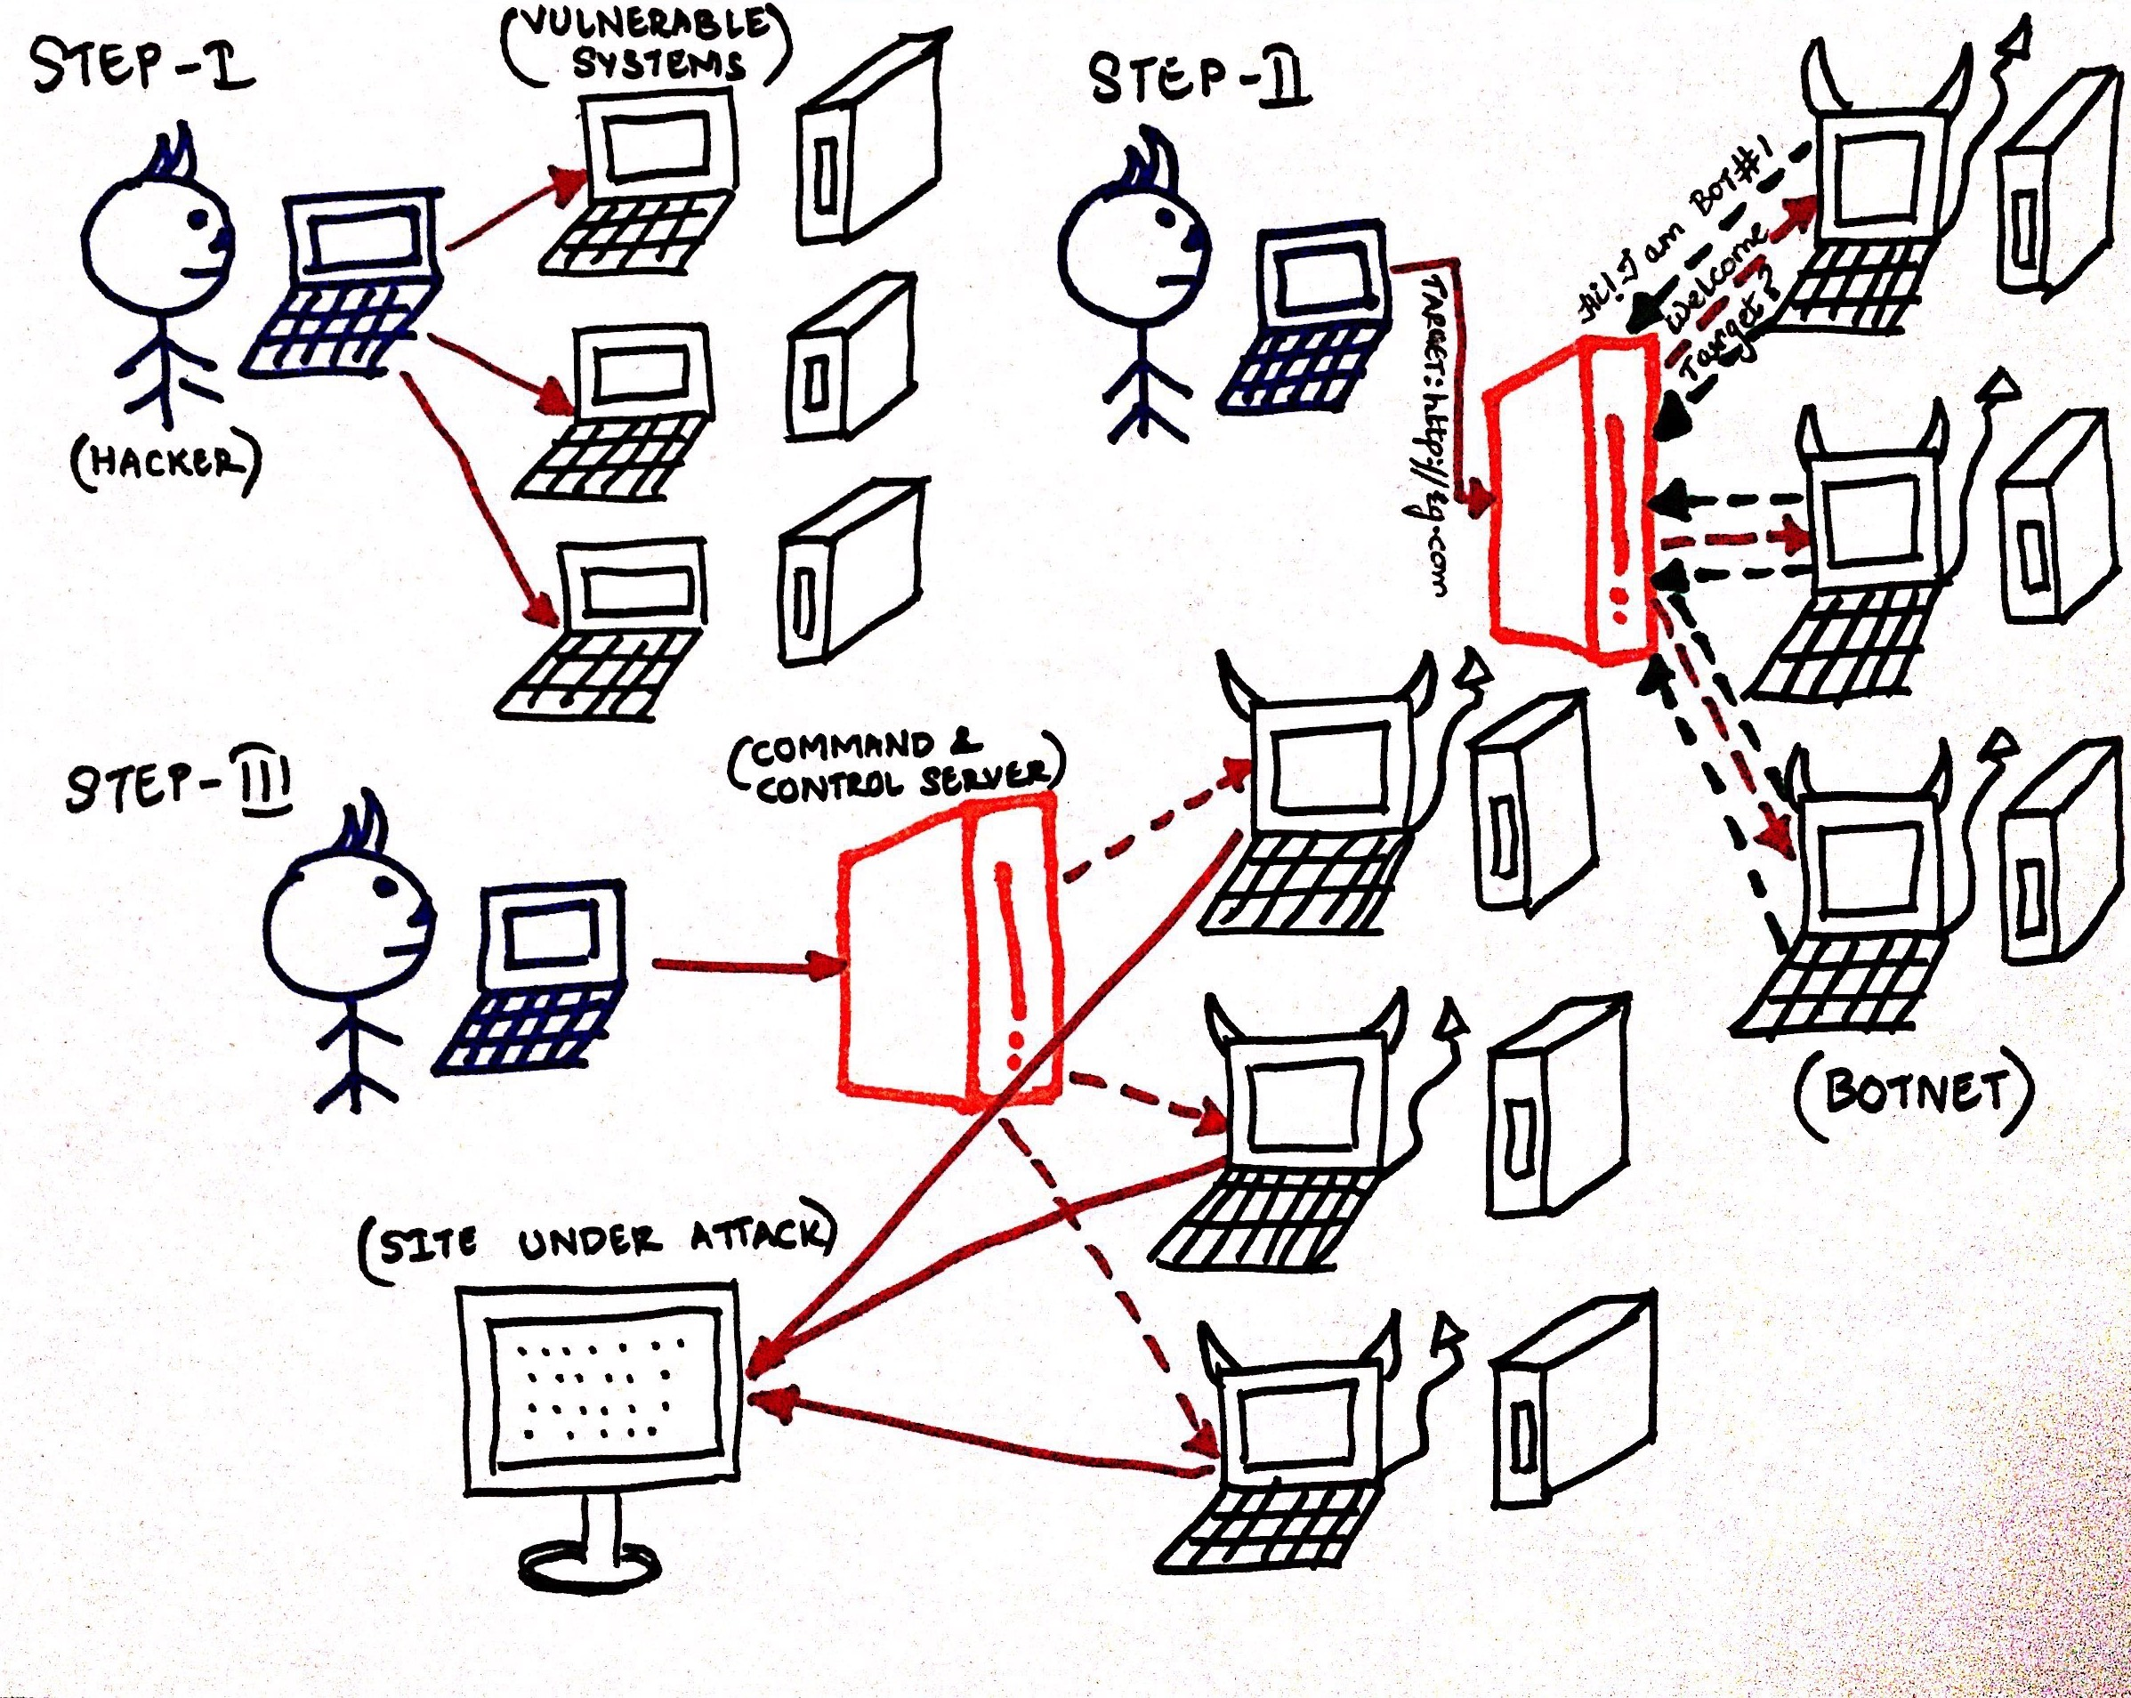
Ddos Attack

Slide 6
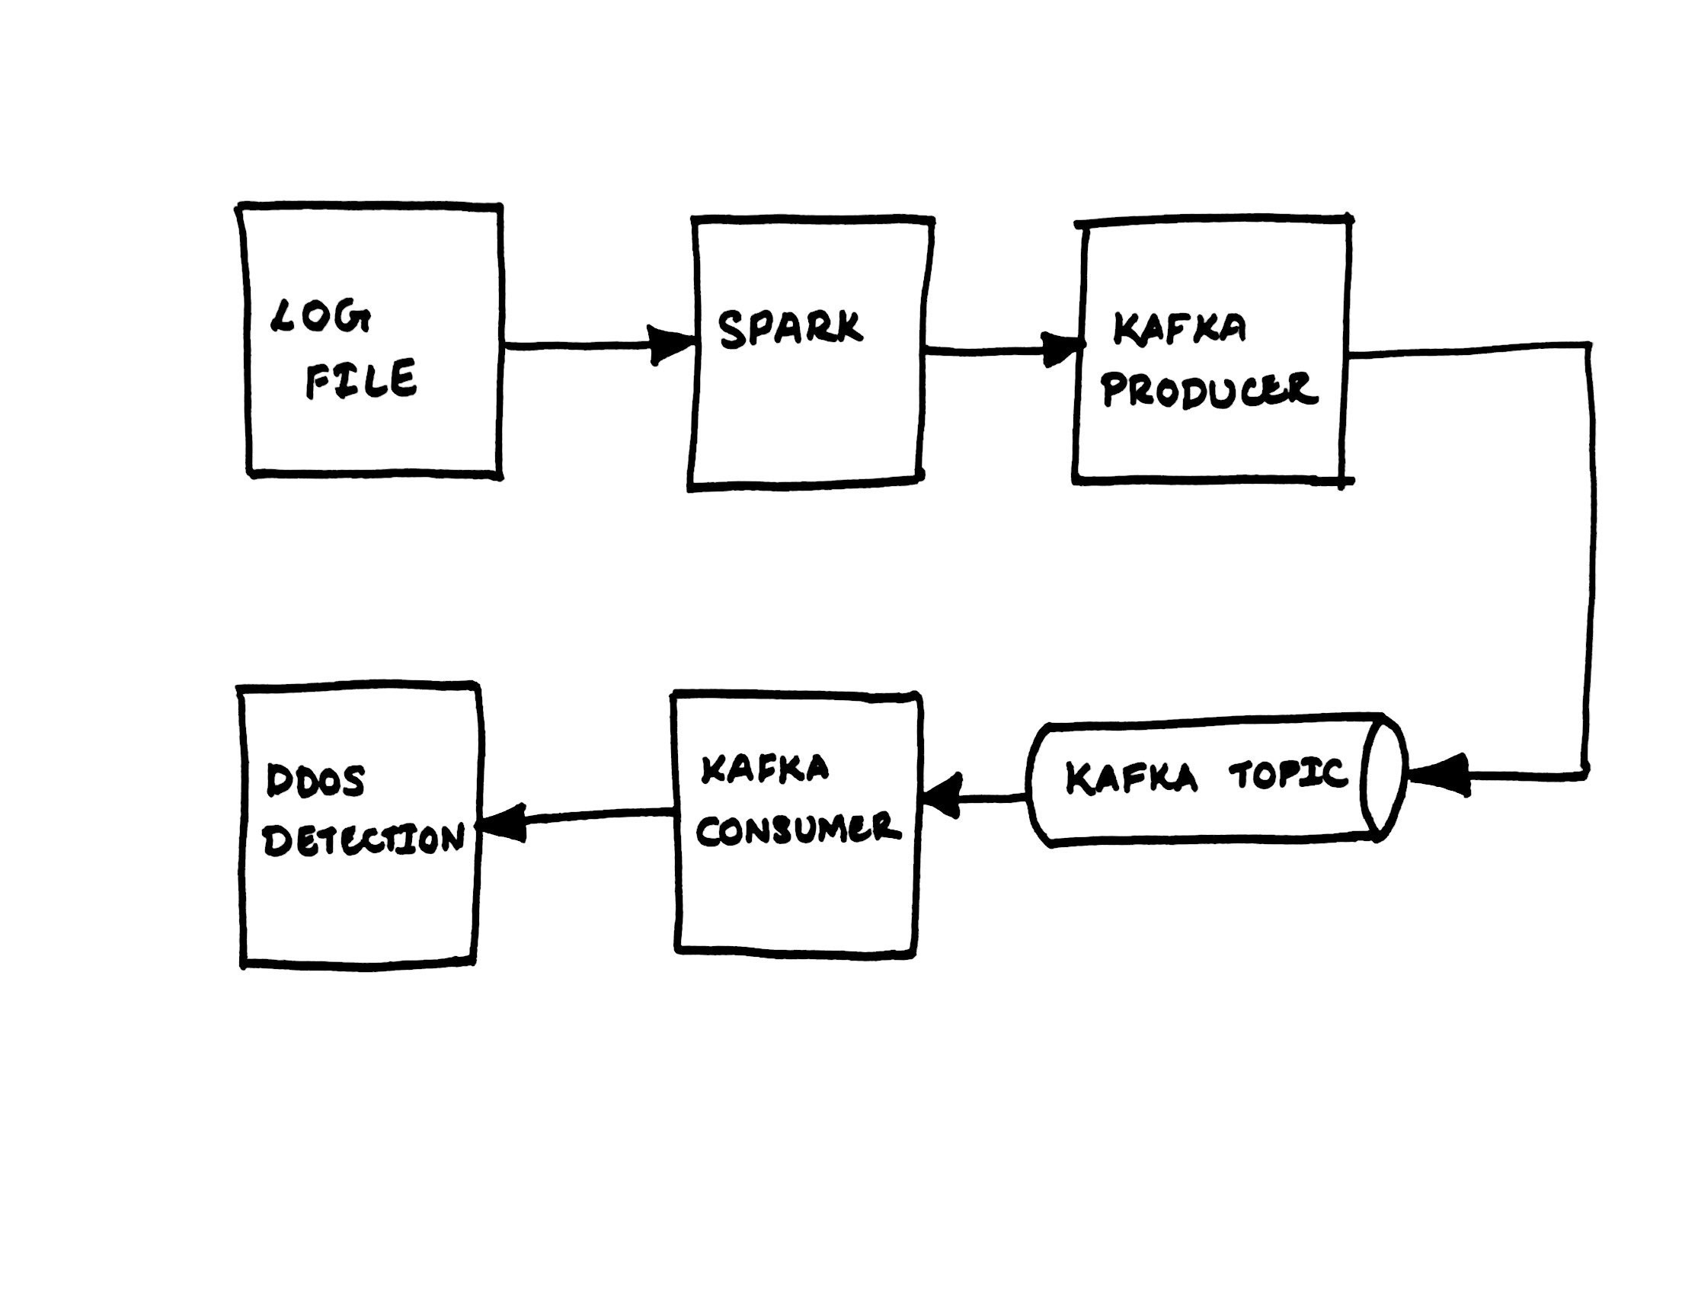
Proposed Solution Architecture

Slide 7
System Requirements
Input
Apache Log file
System Requirements
Hadoop Quick start VM
Spark-1.4.0-bin-hadoop2.6
Scala-2.11.7
Kafka_2.11-0.11.0.1
Sbt-0.13.16
Intellij IDEAD 2017.2.5
Eclipse
JDK 1.7.0

Slide 8
Demo…

Slide 9
Code Explanation
ApacheLogParser.scala
ApacheLogRecord.scala
ApacheLogRecodSpec.scala
ApacheLogParserMain.scala
DdosDetection.java
KafkaConsumer.java
App.java

Slide 10
Challenges Faced
Spark & JDK Version clash
SBT& JDK Version clash

Slide 11
Scaling
Switching from a Pseudo distributed cluster to a fully distributed cluster
Adding multiple brokers to Kafka
Adding a distributed messaging system like Apache Flume at the beginning of the flow to handle stream of incoming files.

Slide 12
Thanks!
Any questions?

